Slide 1

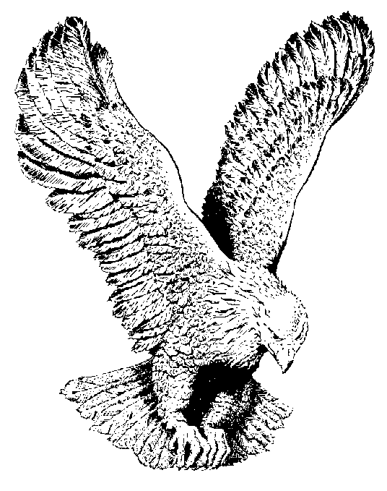
816 MY SHACKLES ARE GONE
My Shackles are gone (echo)
My spirit is free (echo)
O praise the Lord (echo)
He lifted me (echo)
My sins are forgiven (echo)
And now I’m free, (echo)
O praise the Lord, my shackles are gone,
My spirit is free.

